Slide 1
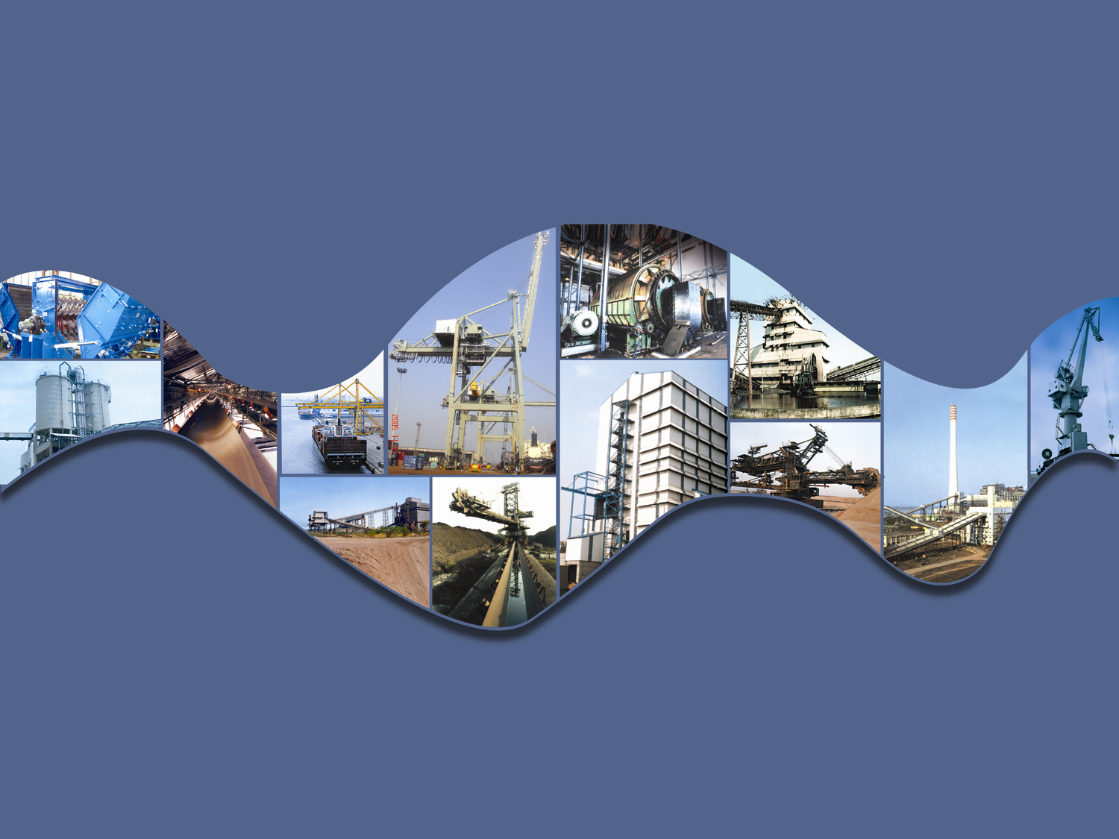


McNALLY SAYAJI ENGINEERING LTD.
COMPANY PROFILE

Slide 2
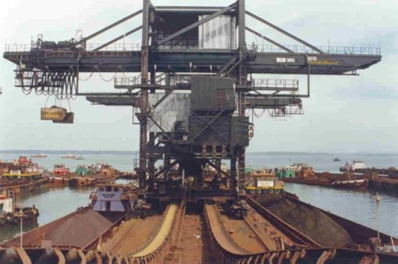
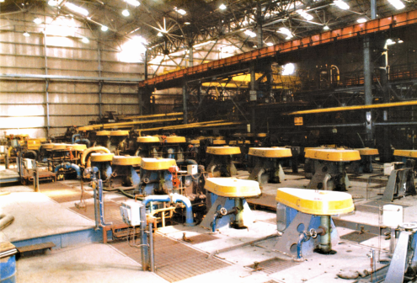
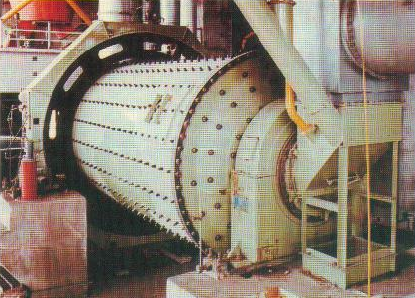
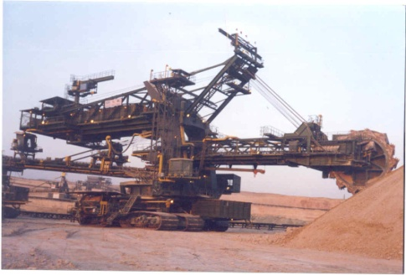
MCNALLY SAYAJI ENGINEERING LTD. (MSEL)
Over 5 decades in business
of
Crushing, Screening and Material Handling Products & Process Equipment for
Mineral and Mining Industry

Slide 3
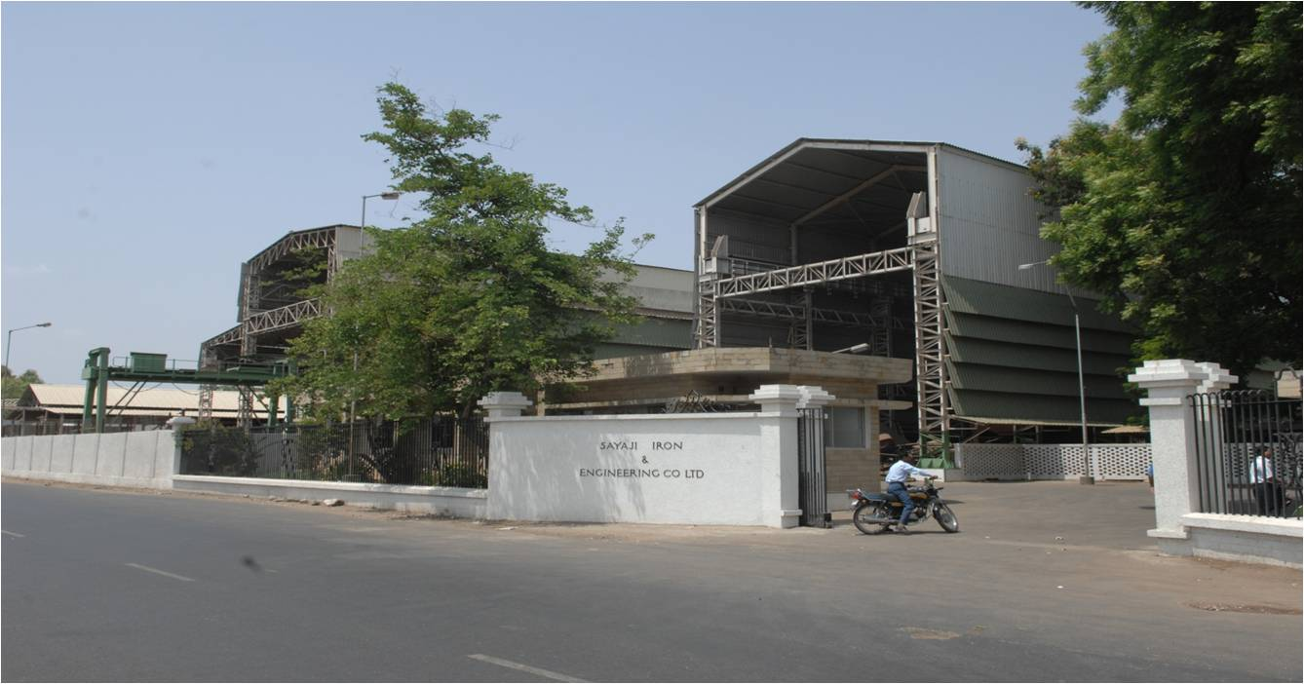
BORN OUT OF COMBINATION OF SAYAJI IRON & ENGINEERING LIMITED
ESTABLISHED IN 1943 AND…..

Slide 4
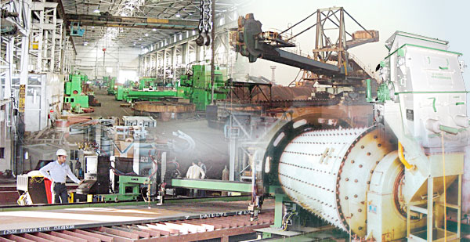
PRODUCT DIVISION OF
MCNALLY BHARAT ENGINEERING LTD.
ESTABLISHED IN 1961

Slide 5
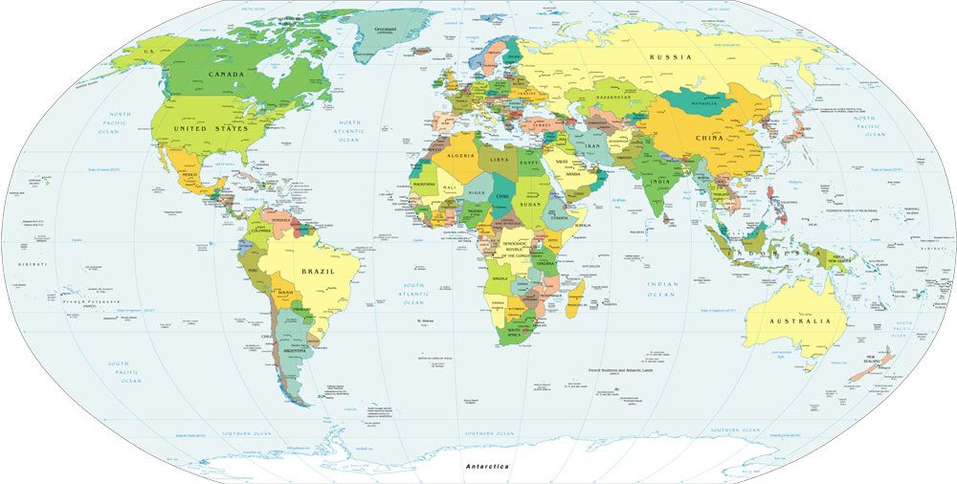
MSEL
KOLKATA (HQ)

Slide 6
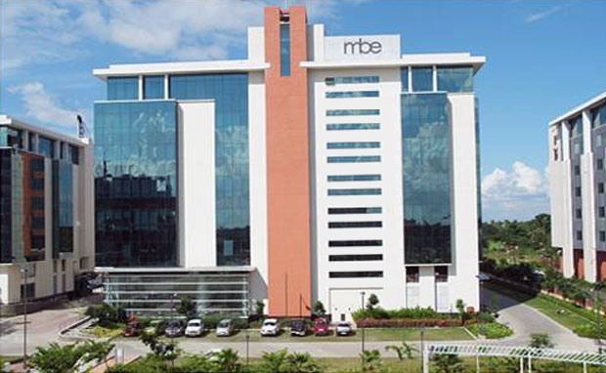
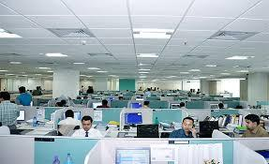
CORPORATE OFFICE :
MCNALLY SAYAJI ENGINEERING LTD
ECOSPACE, CAMPUS 2B,
NEWTOWN
KOLKATA 700156
INDIA

Slide 7
COMPANY LOCATION
Delhi
Kumardhubi
Vadodara
Asansol
Kolkata
Nagpur
Mumbai
Secunderabad
Vizag
Vijaywada
Bangalore
Chennai
MANUFACTURING FACILITIES
CORPORATE OFFICE
OFFICE
Coimbatore
Cochin

Slide 8
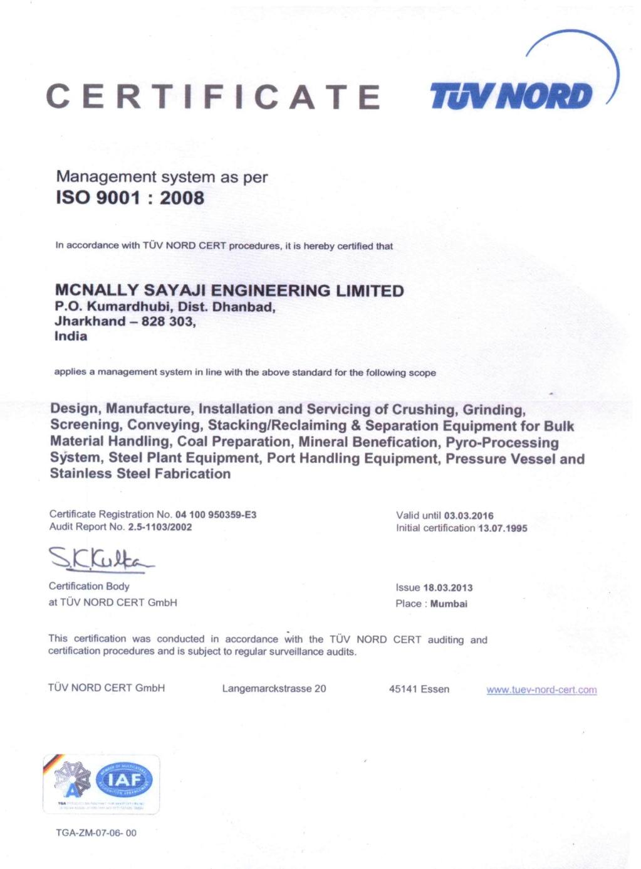
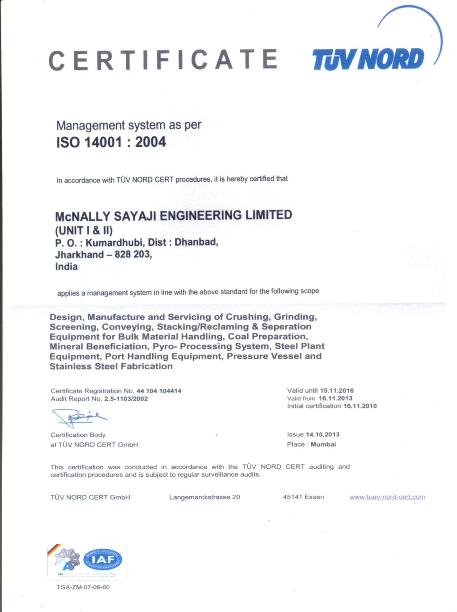
KUMARDHUBI
ISO 9001:2008
ISO 14001:2004

Slide 9
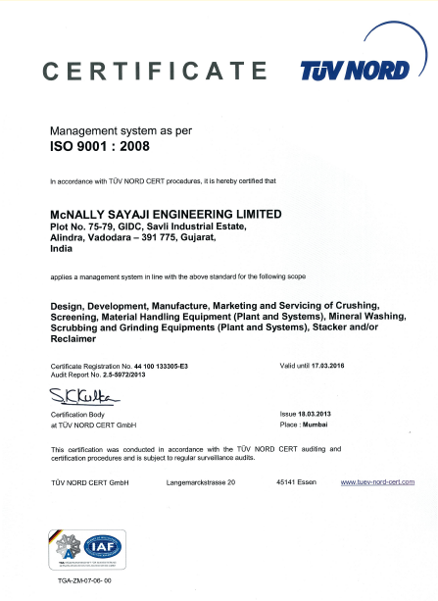
VADODARA
ISO 9001:2008

Slide 10
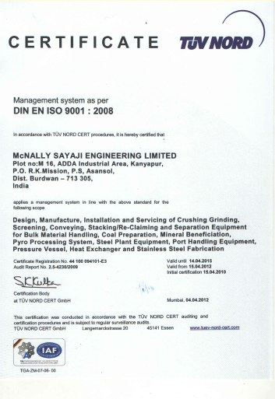
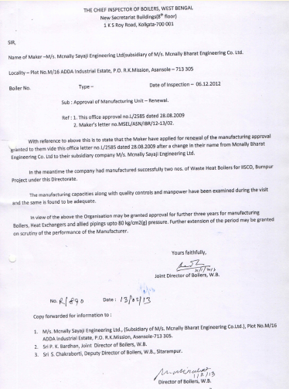
ASANSOL
ISO 9001:2008

Slide 11
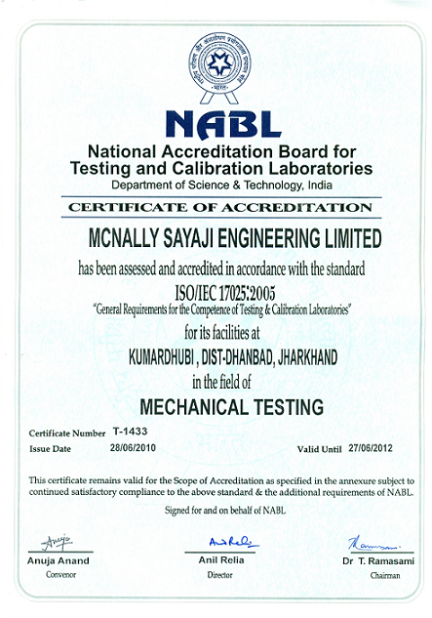
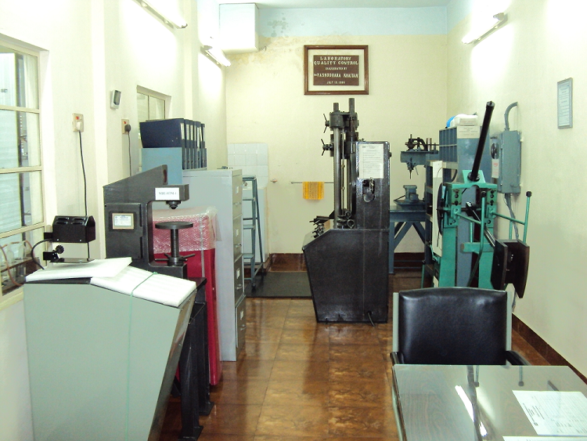
NABL CERTIFICATE FOR
MECHANICAL TESTING LABORATORY

Slide 12
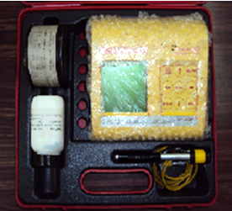
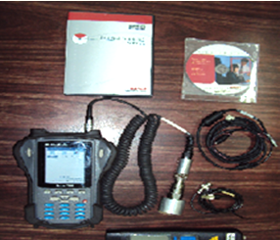
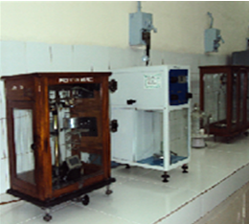
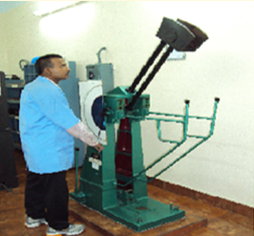
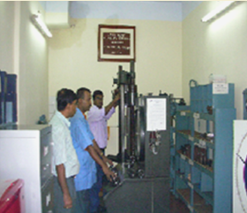
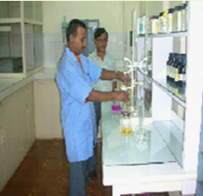
QC & TESTING FACILITIES FOR PRODUCTION SHOPS

Slide 13
MANUFACTURING RANGE
EQUIPMENT FOR :
MATERIAL HANDLING PLANT
COAL HANDLING PLANT
ASH HANDLING PLANT
MOBILE & SEMI MOBILE CRUSHING & SCREENING PLANT
STEEL PLANT
BY PRODUCT PLANT
MINING INDUSTRY
PORT HANDLING SYSTEM
COAL WASHERY
MINERAL BENEFICIATION PLANT
CEMENT PLANT

Slide 14
KUMARDHUBI FACTORY & MANUFACTURING FACILITY

Slide 15
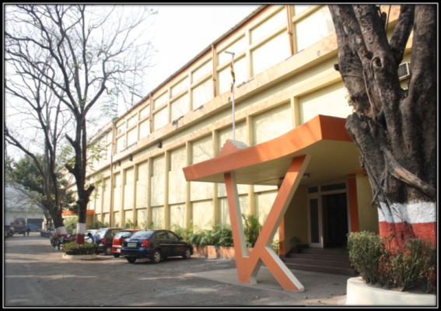
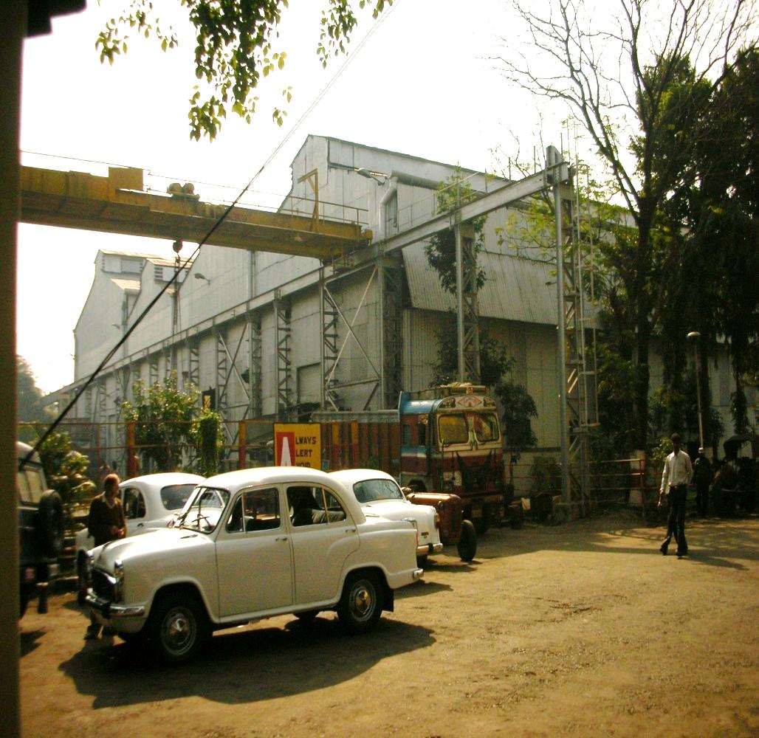
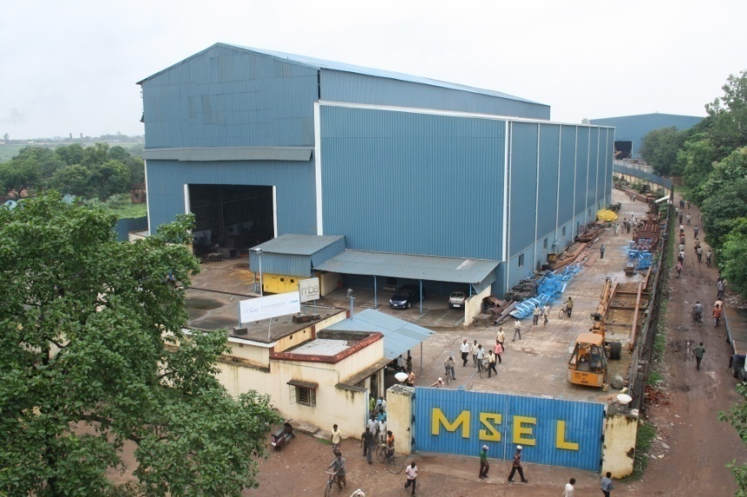
KUMARDHUBI
OPEN AREA :32,250 m²
COVERED AREA:18,750 m²
UNIT - I
UNIT - II

Slide 16
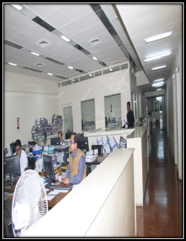
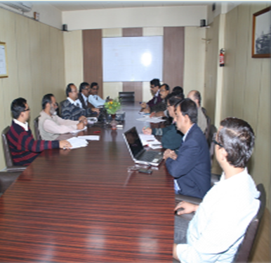
KUMARDHUBI FACTORY - OFFICE

Slide 17
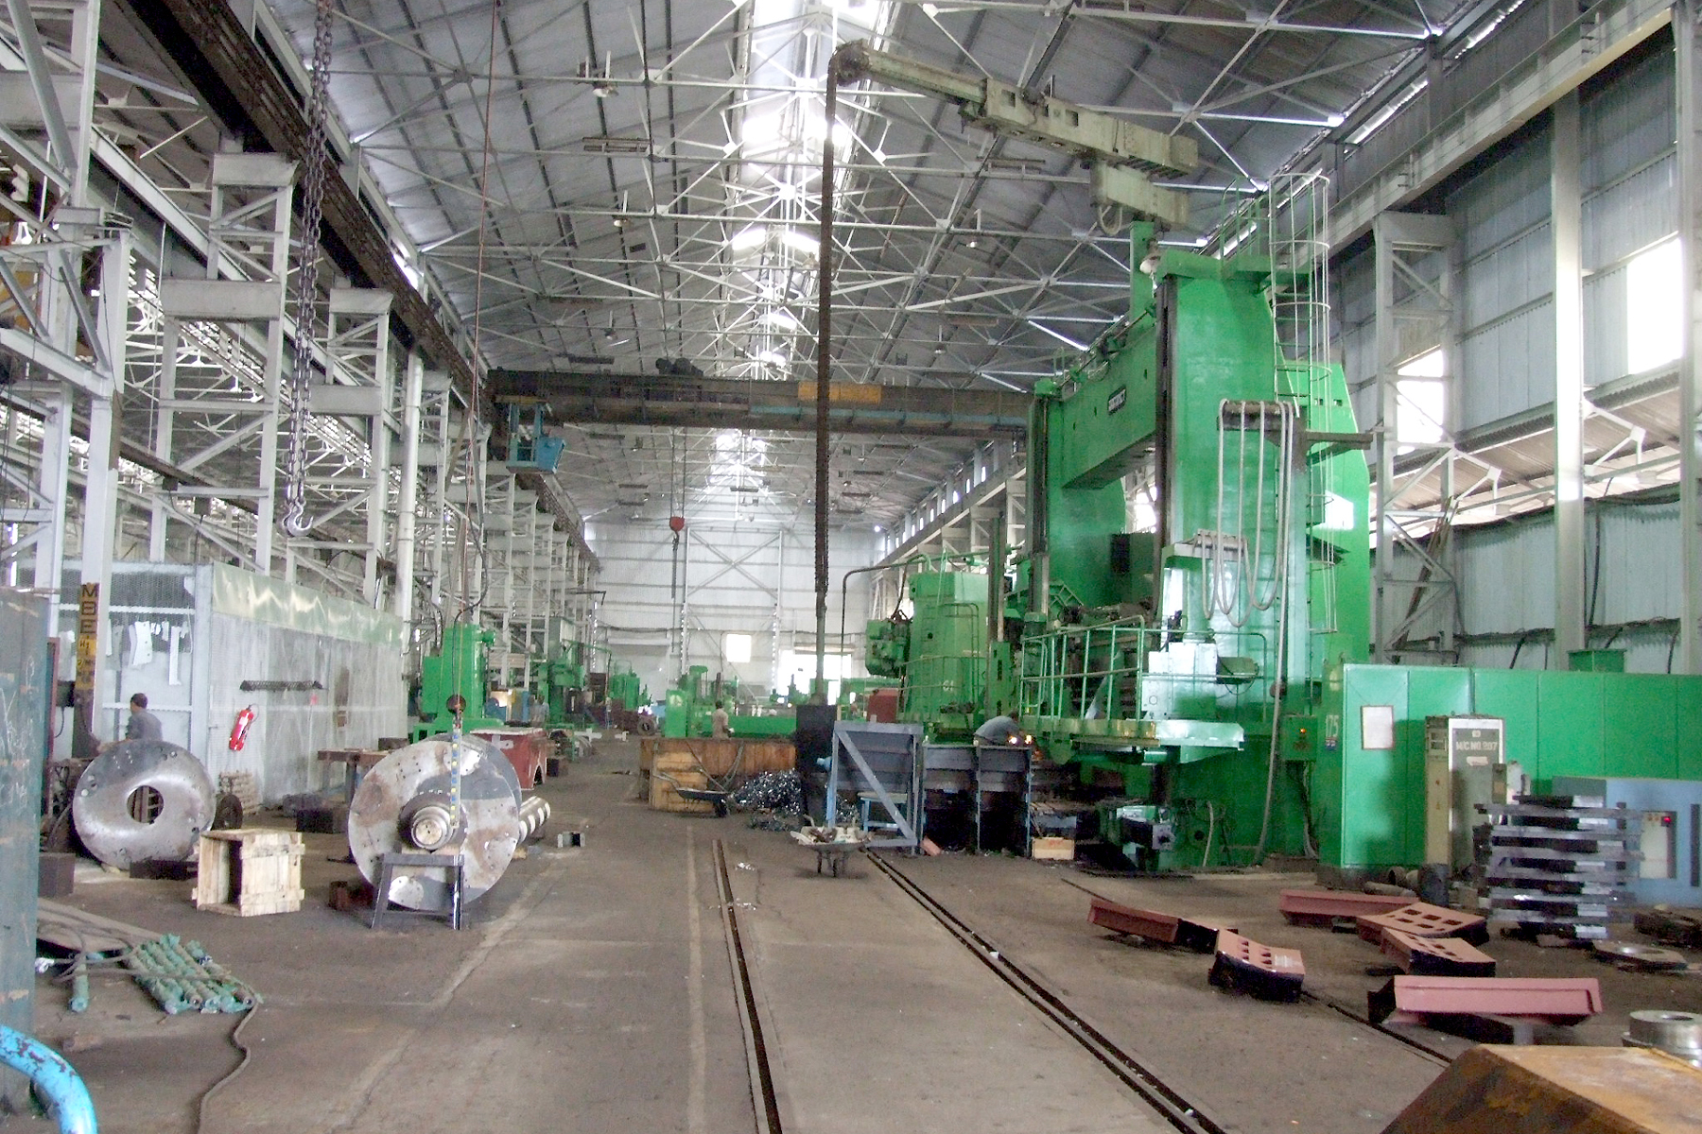
KUMARDHUBI FACTORY-UNIT I
MACHINE SHOP

Slide 18
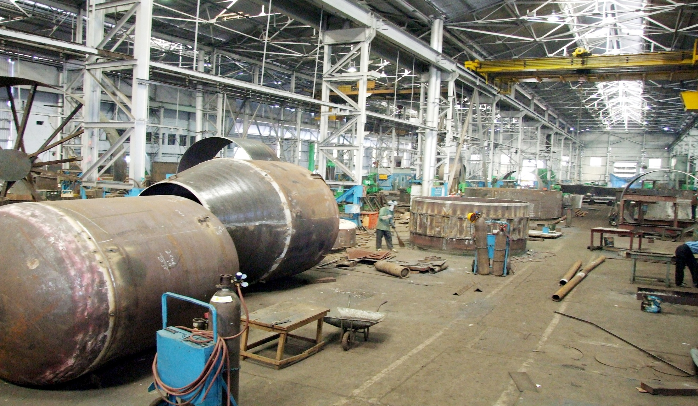
KUMARDHUBI FACTORY-UNIT I
FABRICATION SHOP

Slide 19
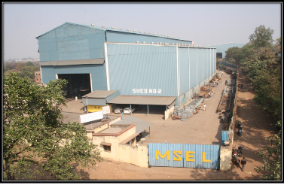
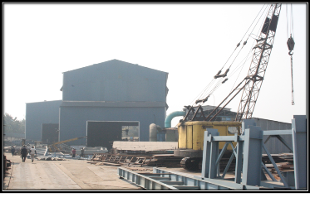
KUMARDHUBI FACTORY -UNIT II

Slide 20
MANUFACTURING FACILITY - KUMARDHUBI
EOT CRANE FACILITY UPTO 70 mt.
PLATE ROLLING FACILITY OF UPTO 120 mm THK.
VERTICAL BORING MACHINE UPTO 8 meters WORK DIA.
SKODA CNC BORING MACHINE WITH 8 meters TRAVEL.
GEAR HOBBING MACHINE 8 meters WORK DIA.
DUAL HEAD CNC (OXY FUEL & PLASMA) PROFILE CUTTING UPTO 200 mm THK
LATHES UPTO 5 meters BED LENGTH

Slide 21
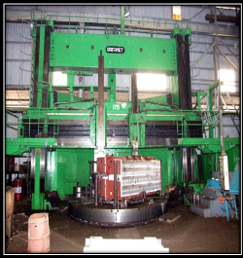
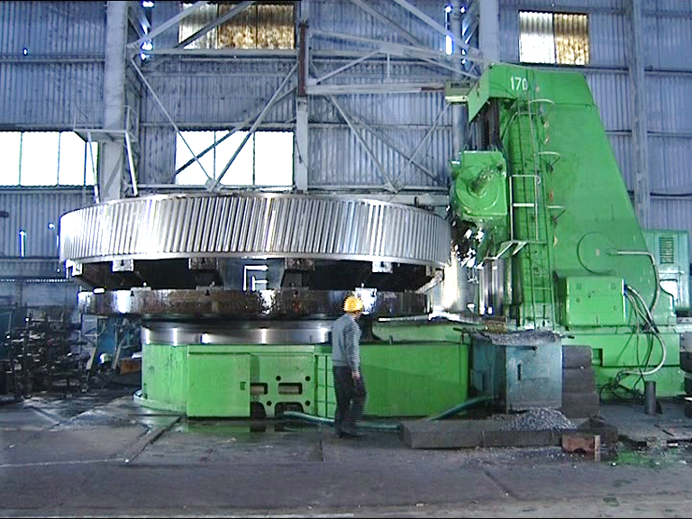
MANUFACTURING FACILITY-KDB
MACHINE | VERTICAL BORING
TABLE DIA | 5000 mm
MAX WORK DIA | 8000 mm
MAX WORK HEIGHT | 4800 mm
MACHINE | GEAR HOBBING
MAX WORK DIA | 8000 mm
MAX CAPACITY | 50 MODULE
MAX FACE WIDTH | 1600 mm

Slide 22
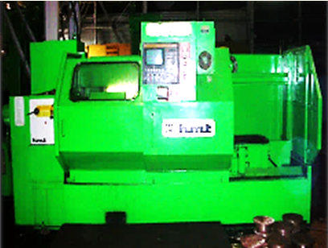
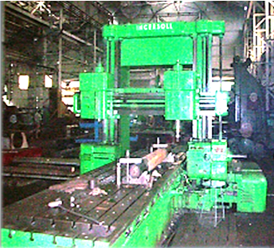
MANUFACTURING FACILITY-KDB
MACHINE | CNC LATHE
MAX WORK DIA | 1600 MM
TURNING HEIGHT | 300 MM
MACHINE | PLANO MILLING
TABLE SIZE | 1600 X 4000 MM
LONG TRAVERSE | 5200 MM
HORIZONTAL TRAVERSE | 2500 MM

Slide 23
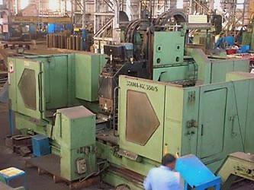
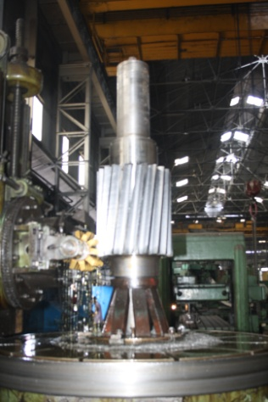
MANUFACTURING FACILITY-KDB
HOBBING OF
PINION SHAFT
MACHINE | CNC VMC
SPINDLE DIA | 100 mm
TRAVEL X AXIS | 2500 mm
TRAVEL Y AXIS | 630 mm
TRAVEL Z AXIS | 700 mm

Slide 24
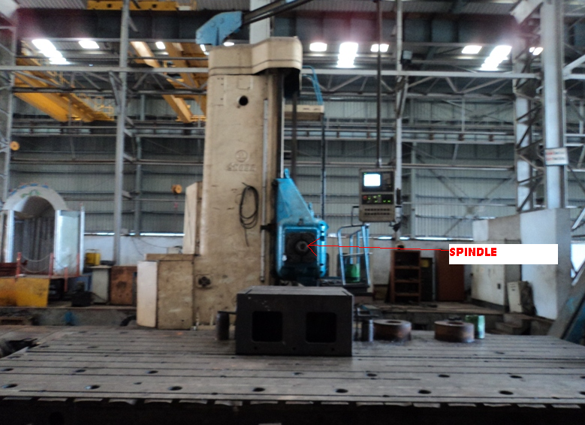
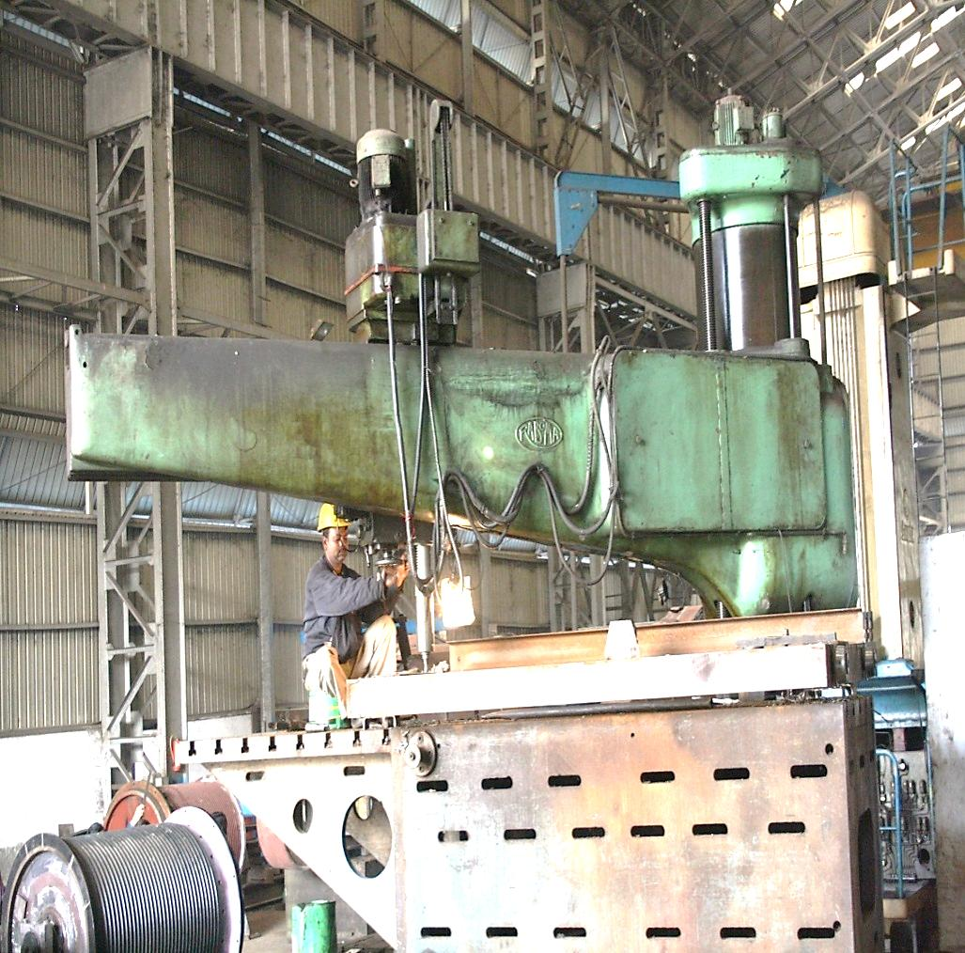
MANUFACTURING FACILITY - KDB UNIT II
MACHINE | RADIAL DRILL
ARM | 3150 mm
FACE WIDTH | 1050 mm
MAX DRILL CAPACITY | 100 mm
MACHINE | CNC BORING
SPINDLE DIA. | 200 mm
TRAVEL X AXIS | 8000 mm
TRAVEL Y AXIS | 3150 mm
TRAVEL Z AXIS | 2000 mm
ROTARY TABLE | 2000 x 2000

Slide 25
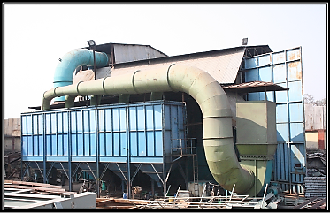
MANUFACTURING FACILITY KDB,UNIT II
SHOT BLASTING 10m (W) X 12m (L) X 8m (H)

Slide 26
VADODARA FACTORY & MANUFACTURING FACILITY

Slide 27
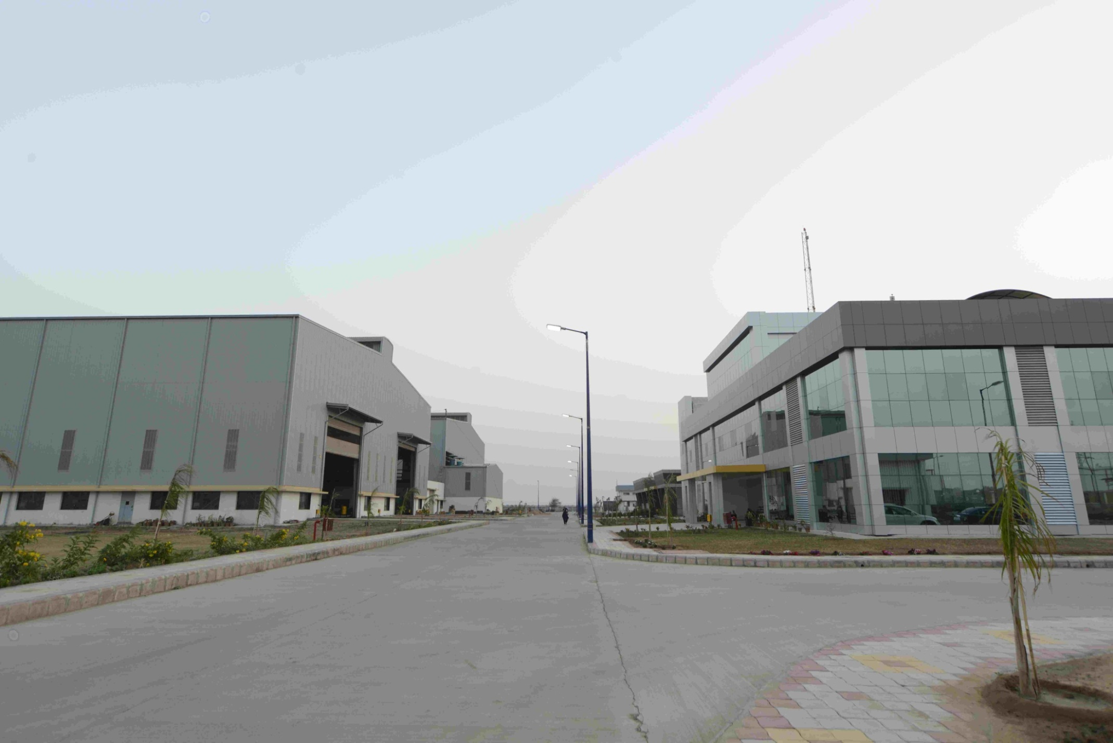
VADODARA FACTORY
OPEN AREA : 58,200m²
COVERED AREA: 42,500m²

Slide 28
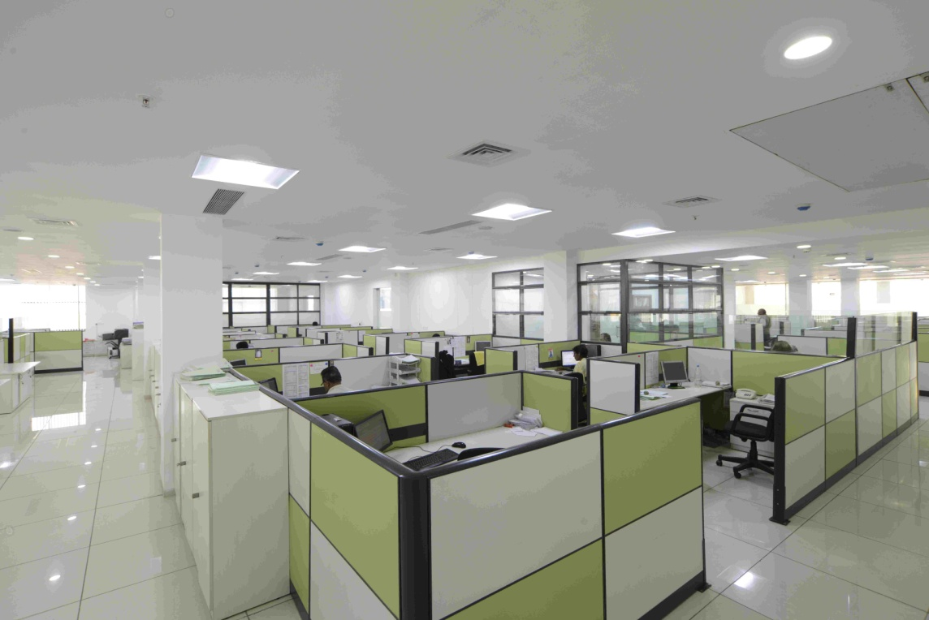
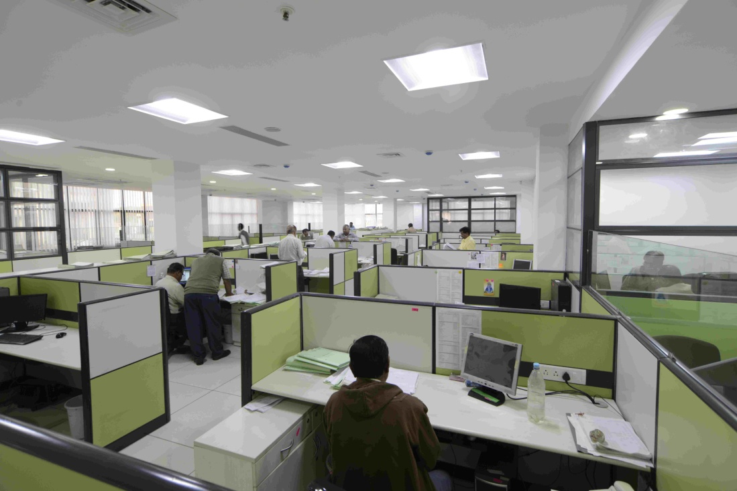
VADODARA FACTORY /OFFICE

Slide 29
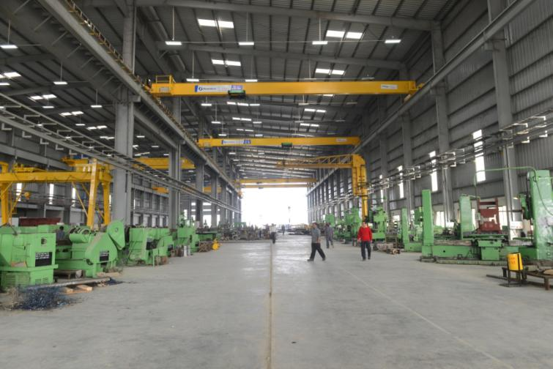
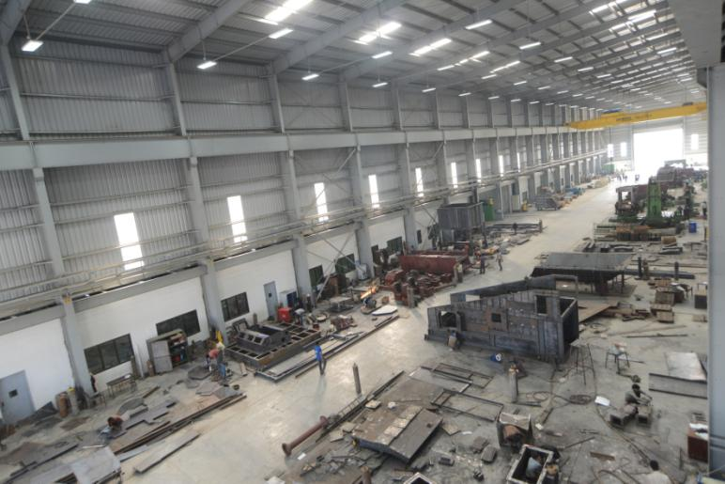
MACHINE SHOP/ FABRICATION SHOP AREA 25X150 mtrs
VADODARA MANUFACTURING FACILITY
ASSEMBLY SHOP/FABRICATION SHOP 3 BAYS-25X150 mtrs. EACH

Slide 30
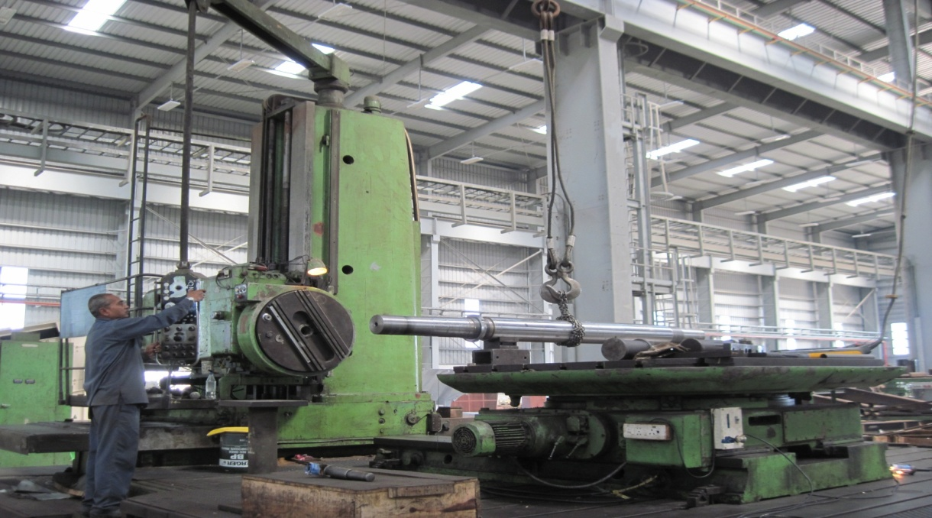
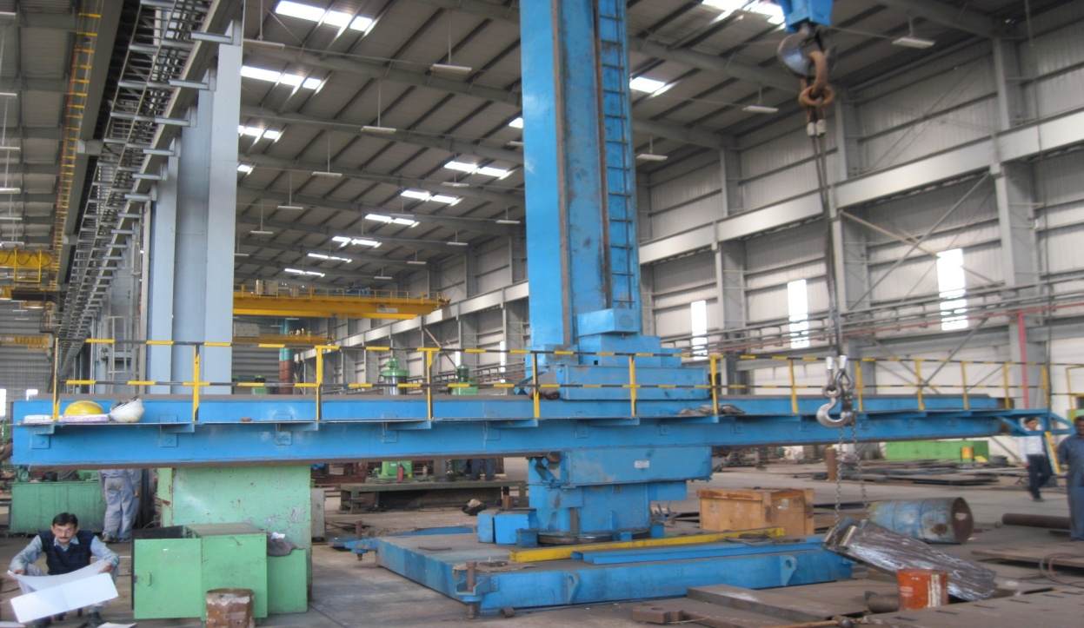
VADODARA MANUFACTURING FACILITY
HORIZONTAL BORING MACHINE-130mm,2mx2m TABLE,
TRAVEL-HORIZONTAL-3m & VERTICAL-1.75m
SUBMERGED ARC WELDING MACHINE-TRAVEL-10m

Slide 31
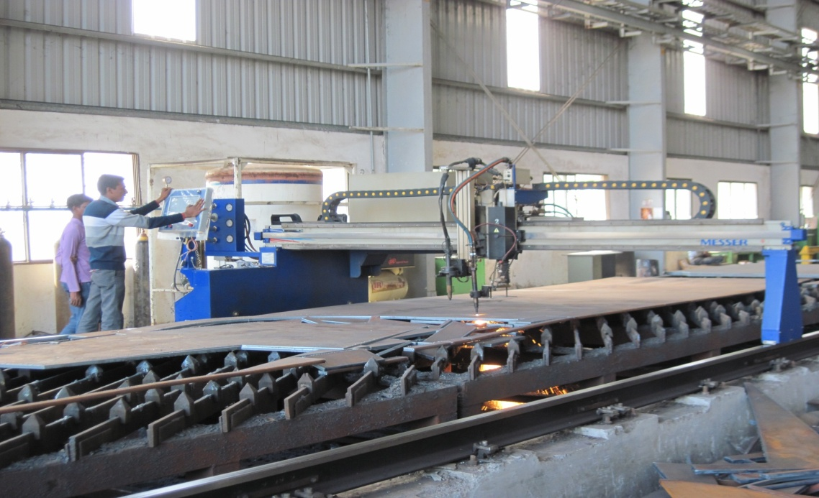
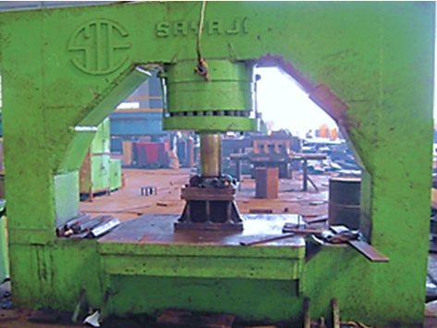
VADODARA MANUFACTURING FACILITY
HYDRAULIC PRESS-CAP 150 t
CNC-PROFILE CUTTING MACHINE-GAS CUTTING UPTO 250mm PLATE THICKNESS.PLASMA CUTTING UPTO 16mm PLATE THICKNESS.BED SIZE 4mtrsx28 mtrs.

Slide 32


VADODARA MANUFACTURING FACILITY
PLANO MILLER 2mx2mx6m
HYDRAULIC PRESS BRAKE-CAPACITY 12mm X 3000mm-150t

Slide 33


VADODARA MANUFACTURING FACILITY
HYDRAULIC SHEARING MACHINE CAPACITY-12mm X 3000mm- 150 t
HORIZONTAL BORING MACHINE- 100mm SPINDLE. CAPACITY -1200X1400mm

Slide 34

VADODARA MANUFACTURING FACILITY
VERTICAL TURRET LATHE-1600mm SWING/1200mm LENGTH

Slide 35
BANGALORE FACTORY & MANUFACTURING FACILITY

Slide 36


BANGALORE FACTORY / OFFICE
OPEN AREA : 16,100 m²
COVERED AREA : 4,500 m²

Slide 37


BANGALORE FACTORY / OFFICE

Slide 38

BANGALORE FACTORY

Slide 39

BANGALORE MANUFACTURING FACILITY
CNC MACHINE
PUMA VTL 900M, 3AXIS, CHUCK DIA 600MM, (MAX TURNING DIA: 900MM,HEIGHT:800MM)

Slide 40

BANGALORE MANUFACTURING FACILITY
CNC TURNING CENTRE, DOOSAN MAKE – MAX TURNING DIAMETER 900 mm IN GAP BED & 640 DIAMETER X 3200 mm LONG BETWEEN CENTRE.

Slide 41

ASANSOL FACTORY & MANUFACTURING FACILITY

Slide 42


ASANSOL FACTORY
OPEN AREA:83,500 m²
COVERED AREA :17,500 m²

Slide 43




ASANSOL FACTORY

Slide 44




MANUFACTURING FACILITY-ASANSOL

Slide 45


MANUFACTURING FACILITY -ASANSOL
CNC TURNING CENTER
MACHINE -DOOSAN | PUMA 600
SWING | 600 mm
CENTRE TO CENTRE | 3200 mm
SPINDLE BORE | 117 mm
MACHINE -DOOSAN | PUMA 400
SWING | 300 mm
CENTRE TO CENTRE | 2100 mm
SPINDLE BORE | 90 mm

Slide 46


MANUFACTURING FACILITY-ASANSOL
CNC HORIZONTAL BORING MACHINE
COLUMN AND BOOM &TROLLEY TYPE SUBMERGED ARC WELDING
DOOSAN | HMC -DB 130 C
BED | 3m/2m/1.6m
SPINDLE DIA | 120 mm
TYPE :CONSTANT POTENTIAL
MODEL :WRCP 1201
OPEN CIRCUIT VOLTAGE :28-52 V
WELDING CURRENT :Upto 1200 A
RATING : 66 kVA
MAX DIA OF JOB :8 m
HORIZONTAL /VERTICAL STROKE :10 m

Slide 47


MANUFACTURING FACILITY-ASANSOL
HORIZONTAL FIVE AXES BORING & MILLING MACHINE
HORIZONTAL FLOOR BORING MACHINE
VISION WIDE- | VMC-VF 6026
BED | 6m/2.6m/1.8m
WMW | HORIZONTAL FLOOR BORING
TRAVEL | 2.5m/13m
SPINDLE DIA | 160 mm

Slide 48


MANUFACTURING FACILITY-ASANSOL
CNC PROFILE CUTTING
MACHINE -PRO-ARC | CNC PROFILE CUTTING MACHINE
CARBON STEEL | 200 mm
STAINLESS STEEL | 32 mm

Slide 49


MANUFACTURING FACILITY-ASANSOL
PLATE BENDING MACHINE
SHOT BLASTING UNIT
MACHINE -HIMALAYA | PLATE BENDING
PLATE THICKNESS | 16mm-150 mm
WIDTH MAX | 3500 mm
16.14m/ 10.82m/ 9m

Slide 50


MANUFACTURING FACILITY-ASANSOL
MILL SHELL TURNING
IN –SITU FLANGE FACING
LARGEST JOB SIZE:
6m DIA. x 22m LONG
IN-SITU FLANGE FACER | (2-8)m, CUTTING DIA, 15H.P.POWERPACK WITH V.F.D

Slide 51



MANUFACTURING FACILITY-ASANSOL
STRINGENT INSPECTION

Slide 52
MSEL PRODUCT RANGE
1. CRUSHING EQUIPMENT
2. SCREENING EQUIPMENT
3. GRINDING EQUIPMENT
4. FEEDING EQUIPMENT
5. MATERIAL HANDLING EQUIPMENT
6. PROCESS PLANT EQUIPMENT
7. ASH HANDLING EQUIPMENT
8. PORT HANDLING EQUIPMENT
9. OPENCAST MINING EQUIPMENT
10. STEEL PLANT EQUIPMENT
11. SKID MOUNTED CRUSHING PLANT
12. WHEEL MOUNTED CRUSHING & SCREENING PLANT
13. JOB SHOP

Slide 53
CRUSHING EQUIPMENT
ROLL CRUSHER : Single Roll Crusher
Toothed Double/ Triple Roll Crusher
Smooth Double Roll Crusher
HEAVY DUTY IMPACTOR
GENERAL DUTY IMPACTOR (EK SERIES)
SWING HAMMER REVERSIBLE IMPACTOR
REVERSIBLE HAMMER MILL
ONE WAY HAMMER MILL
RING GRANULATOR
JAW CRUSHER : Single Toggle Jaw Crusher
Double Toggle Jaw Crusher
CONE CRUSHER
COKE CUTTER
ROTARY BREAKER
CHAIN MILL
LUMP LOOSENER
SINGLE ROLL LUMP BREAKER (SIZES 600 mm TO 710mm DIA & 100mm TO 2000mm DIA)

Slide 54


SINGLE ROLL CRUSHER
CRUSHING EQUIPMENT
ROLL CRUSHER
SIZES:
ROLL DIA - 500 mm to 1800 mm
ROLL WIDTH -450 mm to 2800 mm

Slide 55


CRUSHING EQUIPMENT
ROTORS OF TOOTHED DOUBLE ROLL CRUSHER
TRIPLE ROLL CRUSHER
FOR TWO STAGE REDUCTION IN A SINGLE UNIT. USED FOR COAL, LIME STONES, FERTILIZERS AND CHEMICALS

Slide 56

CRUSHING EQUIPMENT
SMOOTH DOUBLE ROLL CRUSHER
SIZES:
FROM 400 mm DIA X 250 mm LONG
TO 1200 mm DIA X 1200 mm LONG

Slide 57


CRUSHING EQUIPMENT
DOUBLE ROLL CRUSHER
DIAMETER 500 mm TO 1600 mm,
WIDTH 500 mm TO 3800 mm,
CAPACITY RANGE 10 tph to 800 tph

Slide 58


CRUSHING EQUIPMENT
HEAVY DUTY IMPACTOR
DIAMETER 600 mm TO 1600 mm,
WIDTH 600 mm TO 1600 mm,

Slide 59

CRUSHING EQUIPMENT
HEAVY DUTY IMPACTOR
SINGLE ROTOR SIZES :
FROM 900mm DIA X 1100 mm LONG
TO 1500 mm x 1800 mm
DOUBLE ROTOR SIZES :
FROM 48” DIA X 50” LONG
TO 54” DIA X 62” LONG

Slide 60


CRUSHING EQUIPMENT
EK SERIES IMPACTOR
DIAMETER 800 mm TO 1800 mm,
WIDTH 800 mm TO 2400 mm,
CAPACITY UPTO 600 tph FOR 15mm PRODUCT
ROTOR OF 1800 mm DIA X 2400 mm WIDE 600 tph COAL IMPACTOR

Slide 61


REVERSIBLE HAMMER MILL
CRUSHING EQUIPMENT
SIZES:
FROM 400 mm DIA X 400 mm LONG
TO 2000 mm DIA x 2200 mm LONG

Slide 62

CRUSHING EQUIPMENT
ONE WAY HAMMER MILL
SIZES:
600 mm DIA. X 1000 mm LG.
950 mm DIA. X 1650 mm LG.

Slide 63

CRUSHING EQUIPMENT
RING GRANULATOR
SIZES :
FEED OPENING FROM 500 mm X 1100 mm
TO 1000 mm X 3300 mm

Slide 64

CRUSHING EQUIPMENT
SINGLE TOGGLE JAW CRUSHER
SIZES FROM 250 mm X 900 mm
TO 1050 mm X 1200 mm.

Slide 65



CRUSHING EQUIPMENT
DOUBLE TOGGLE JAW CRUSHER
SIZES FROM 300 mm X 175 mm
TO 1500 mm X 1200 mm.

Slide 66



CRUSHING EQUIPMENT
DOUBLE TOGGLE JAW CRUSHER

Slide 67


CRUSHING EQUIPMENT
CONE CRUSHER
500 mm TO 1200 mm DIA

Slide 68

CRUSHING EQUIPMENT
ROTARY BREAKER
SIZE:
FROM 12’ DIA. X 18’ LONG
TO 12’ DIA. X 27’ LONG

Slide 69

CRUSHING EQUIPMENT
DUAL CHAIN MILL
SIZE:
FROM 890 mm DIA. X 865 mm LONG
TO 1000 mm DIA. X 1060 mm LONG

Slide 70
SCREENING EQUIPMENT
CIRCULAR MOTION VIBRATING SCREEN
LINEAR MOTION VIBRATING SCREEN
ROLLER SCREEN
LIVE ROLL GRIZZLY (SIZE: 1200 mm WIDE X 3800 mm LG, 1200 mm WIDE X 4400 mm LG.)
HIGH PARTICLE ACCELERATION SCREEN
BANANA SCREEN
SCREENING FEEDER

Slide 71



SCREENING EQUIPMENT
CIRCULAR MOTION VIBRATING SCREEN
WIDTH 600 mm TO 2500 mm &
LENGTH 1300 mm TO 7000 mm,

Slide 72


SCREENING EQUIPMENT
LINEAR MOTION VIBRATING SCREEN
SIZES :
FROM 1200 mm WIDE X 2500 mm LONG
TO 3400 mm WIDE X 6500 mm LONG

Slide 73


ROLLER SCREEN
SCREENING EQUIPMENT
SIZES :
FROM 1500 mm WIDE X 3000 mm LONG
TO 2400 mm WIDE X 6000 mm LONG

Slide 74


SCREENING EQUIPMENT
HIGH PARTICLE ACCELARATION SCREEN
SIZES :
FROM 1500 mm WIDE X 4410 mm LONG
TO 2000 mm WIDE X 8800 mm LONG

Slide 75
GRINDING EQUIPMENT
BALL MILL
ROD MILL
VIBRATING TUBE MILL

Slide 76


GRINDING EQUIPMENT
BALL MILL
SIZE: UPTO 4.8 m DIA
MOTOR :UPTO 4600 kw
FEED:80% MINUS 20 mm
PRODUCT:80% MINUS 44 MICRONS
LARGEST SIZE BALL MILL SHELL
4.8 m Dia X 8.0 M LG (FOR DEIFY)

Slide 77

ROD MILL
GRINDING EQUIPMENT
SIZE: UPTO 4.4 m DIA
LENGTH : UPTO 6.3 m

Slide 78


GRINDING EQUIPMENT
VIBRATING TUBE MILL
HIGHLY EFFICIENT FINE GRINDING MILLS WHICH CONSUME LESS POWER AND SPACE. IDEAL FOR GRINDING IN REFRACTORY INDUSTRY, SILICON CARBIDE AND FUSED ALUMINA IN GRINDING WHEEL INDUSTRY, SLAG GRINDING FOR STEEL PLANTS ETC.
AVAILABLE IN TWIN TUBES AS WELL AS THREE TUBE DESIGNS
200 mm DIA TO 600 mm DIA AND 1500 mm LONG TO 3500 mm LONG, CAPACITY RANGE 10 Kgs TO 1500 Kgs PER HOUR

Slide 79
FEEDING EQUIPMENT
APRON FEEDER
RECIPROCATING FEEDER
VIBRATORY FEEDER
DISC FEEDER (DIAMETER UPTO 1500 mm)
GRIZZLY FEEDER
BELT FEEDER
PADDLE FEEDER

Slide 80


FEEDING EQUIPMENT
APRON FEEDER
SIZES UPTO 2600 mm WIDTH & LENGTH TO SUIT THE ACTUAL REQUIREMENT

Slide 81


FEEDING EQUIPMENT
APRON FEEDER
ONE OF THE LONGEST APRON CONVEYORS IN THE WORLD 74.10 m LONG, 1.2 m WIDE WAS EXPORTED FOR SOHAR ALUMINIUM, OMAN THROUGH SOLIOS, FRANCE.

Slide 82

FEEDING EQUIPMENT
RECIPROCATING FEEDER
SIZE: WIDTH 24”,30”,36”,42”,48”,54”,60”,66”,72”,80”
CAPACITY: UP TO 1200 tph

Slide 83


FEEDING EQUIPMENT
GRIZZLY FEEDER
PADDLE FEEDER
SIZE: UPTO 8‘ WIDE X 20‘ LONG
CAPACITY RANGE:
FROM 200 tph to 5000 tph

Slide 84
MATERIAL HANDLING EQUIPMENT
WAGON TIPPLER
SIDE ARM CHARGER
STACKER RECLAIMER
BUCKET ELEVATOR
TRIPPER
BELT CONVEYOR & COMPONENTS
SCREW CONVEYOR
GRAVITY ROLLER CONVEYOR
POWERED ROLLER CONVEYOR
EOT CRANE ( FROM 35 tons to 100 tons )

Slide 85


MATERIAL HANDLING EQUIPMENT
WAGON TIPPLER
CAPACITY | 110 Ton
TYPE | ROTASIDE
NO OF TIPS | 20 PER HOUR
FOR VEDANTA ALUMINA LTD JHARSUGUDA

Slide 86


MATERIAL HANDLING EQUIPMENT
COMPONENTS OF WAGON TIPPLER
FOR VIZAG STEEL PLANT

Slide 87

MATERIAL HANDLING EQUIPMENT
COMPONENTS OF WAGON TIPPLER

Slide 88


MATERIAL HANDLING EQUIPMENT
SIDE ARM CHARGER
FOR VEDANTA ALUMINA LTD JHARSUGUDA
CAPACITY :59 WAGONS

Slide 89

MATERIAL HANDLING EQUIPMENT
STACKER - RECLAIMER
ADANI PORT (MUNDRA)
BIGGEST CAPACITY STACKER - RECLAIMER MANUFACTURED IN INDIA
CAPACITY | 6000 X 2500 tph
TRACK GAUGE | 10000 mm
MATERIAL | COAL
BOOM LENGTH | 41000 mm

Slide 90


MATERIAL HANDLING EQUIPMENT
STACKER - RECLAIMER
CAPACITY | 2500 X 1850 tph
TRACK GAUGE | 8000 mm
MATERIAL | COAL
BOOM LENGTH | 35000 mm
ESSAR POWER SALAYA,JAMNAGAR
STACKER
CAPACITY | 3000 tph
TRACK GAUGE | 8000 mm
BOOM LENGTH | 31000 mm
ESSAR STEEL- PARADIP

Slide 91




MATERIAL HANDLING EQUIPMENT
COMPONENTS OF STACKER RECLAIMER

Slide 92



MATERIAL HANDLING EQUIPMENT
COMPONENTS OF STACKER RECLAIMER
UNDERCARRIAGE STRUCTURE
SLEW SUPER STRUCTURE
MAST HORIZONTAL

Slide 93


MATERIAL HANDLING EQUIPMENT
COMPONENTS OF STACKER RECLAIMER
BUCKET WHEEL STRUCTURE
SLEW SUPER STRUCTURE ( Weight 110 mt)

Slide 94


MATERIAL HANDLING EQUIPMENT
GRAVITY ROLLER CONVEYOR FOR VEDANTA
POWERED ROLLER CONVEYOR
FOR VEDANTA ALUMINA

Slide 95
ASH HANDLING EQUIPMENT
TRANSPORTER VESSEL
AIR RECEIVER
CLINKER CRUSHER
PADDLE MIXER
SCRAPER CHAIN CONVEYOR
BAG FILTER
In Association with MBE

Slide 96



ASH HANDLING EQUIPMENT
PNEUMATIC ASH HANDLING
AIR RECEIVER
ASH TRANSPORTER VESSEL

Slide 97


ASH HANDLING EQUIPMENT
SCRAPER CHAIN CONVEYOR

Slide 98


ASH HANDLING EQUIPMENT
PADDLE MIXER
ASH VALVE

Slide 99
PROCESS PLANT EQUIPMENT
SLURRY PUMP
FLOTATION CELL
COLUMN FLOTATION CELL
THICKENERS
CETRIFUGAL GRAVITY CONCENTRATOR
MAGNETIC SEPARATOR
FILTERS
ROTARY SCRUBBER

Slide 100


MEDIUM DUTY PUMPS TYPE MV
PROCESS PLANT EQUIPMENT
SLURRY PUMP
HEAVY DUTY VASA HD PUMPS
AVAILABLE IN 9 SIZES – 25mm to 200mm DISCHARGE
CATERING TO FLOWS UPTO 600 m3/hr
AVAILABLE IN SIZES – 40mm to 300 mm DISCHARGE
CATERING TO FLOWS UPTO 3000 m3/hr

Slide 101


VERTICAL SUMP PUMPS – (TYPE MG)
PROCESS PLANT EQUIPMENT
SLURRY PUMP
CONE PUMP (TYPE – SPVC)
AVAILABLE IN 80CM, 120CM & 180cm FRAME LENGTHS SUITABLE FOR SUMPS UPTO 2.3 m DEEP
AVAILABLE IN SIZES FROM 50 mm to 200 mm CAPABLE OF HANDLING CAPACITIES UPTO 600 m3/hr

Slide 102


FLOTATION CELL - MECHANICAL
PROCESS PLANT EQUIPMENT
SOME MAJOR CLIENTS:
HINDUSTAN ZINC LTD FOR ZINC & LEAD
TATA STEEL LTD FOR COAL
HINDALCO INDUSTRIES LTD,COPPER SLAG
ACC LTD, LIMESTONE
KONKOLA COPPER MINES,ZAMBIA FOR COPPER ORE
IREL FOR SILLIMANITE
AVAILABLE SIZES
MB 40 – 40 m³
MB 17 - 17 m³
MB 8 - 8 m³
MB 3-- 3 m³
MB 1.5 – 1.5 m³

Slide 103


COLUMN FLOTATION CELL
PROCESS PLANT EQUIPMENT

Slide 104
PROCESS PLANT EQUIPMENT
Wash Water
Column Flotation
Conventional Flotation
Froth
Feed
Air
Froth
Air
Feed
Sink
Sink

Slide 105

THICKENER
PROCESS PLANT EQUIPMENT
THE SIZE OF THICKENER RANGES
FROM 5 m TO 65 m DIAMETER.

Slide 106


PROCESS PLANT EQUIPMENT
THICKENER
INSTALLATIONS IN INDIA AS WELL AS IN RUSSIA, ROMANIA, QATAR, INDONESIA, ZAMBIA, SAUDI ARABIA AND BOSNIA.

Slide 107
GRAVITY EQUIPMENT
PROCESS PLANT EQUIPMENT
CENTRIFUGAL GRAVITY CONCENTRATORS
MSEL REPRESENTS SEPRO MINERAL SYSTEMS, CANADA FOR THEIR RANGE OF CENTRIFUGAL GRAVITY CONCENTRATORS. RANGE INCLUDES BATCH (SB), CONTINUOUS ( C) AND ULTRAFINE ( UF) TYPES OF MACHINES WHICH EMPLOY HIGH ‘G’ FORCES TO ACHIEVE SEPARATION BETWEEN MINERAL AND GANGUE PARTICLES WHERE THE SG DIFFERENCE IS 0.5 OR MORE. MACHINES THAT CAN HANDLE UPTO 400 TPH ARE AVAILABLE .

Slide 108


PROCESS PLANT EQUIPMENT
ROTARY SCRUBBER
SIZES: 1.8 m DIA X 3.6 m LONG
TO 3 m DIA X 9 m LONG
CAPACITY: UP TO 600 tph

Slide 109
PROCESS PLANT
COMPREHENSIVE SOLUTIONS TO DESIGN AND BUILD MINERAL PROCESSING PLANTS AS PER INDIVIDUAL CUSTOMER REQUIREMENTS
SOLUTIONS FOR A RANGE OF MINERALS
IRON ORE LIMESTONE
COPPER BARYTE
LEAD – ZINC ROCK PHOSPHATE
CHROMITE
GOLD
SERVICES OFFERED
ASSISTANCE WITH TESTING
BASIC ENGINEERING BASED ON TEST REPORTS
DETAILED ENGINEERING
EQUIPMENT SUPPLY AS PER CLIENT REQUIREMENT
SUPERVISION OF ERECTION
SUPERVISION OF COMMISSIONING

Slide 110
PORT HANDLING EQUIPMENT
BARGE UNLOADER
CONTAINER HANDLING CRANE
BULK HANDLING CRANE
SHIPYARD CRANE
In Association with MBE

Slide 111


PORT HANDLING EQUIPMENT
BARGE UNLOADER
SUPPLIED TO MURMUGOA PORT TRUST
CAPACITY 750 tph
CONTAINER HANDLING CRANE
SHIP TO SHORE CRANES
RUBBER TYRED GANTRY CRANE
RAIL MOUNTED GANTRY CRANE

Slide 112



PORT HANDLING EQUIPMENT
BULK HANDLING CRANE
CAPACITY | 45 t
TRACK GAUGE | 8000 mm
RADIUS | 35000 mm
MAX. HEIGHT OF LIFT | 50000 mm

Slide 113

PORT HANDLING EQUIPMENT
SHIPYARD CRANE - GOLIATH GANTRY CRANE
BIGGEST GOLIATH CRANE SUPPLIED TO MAZGAON DOCK LTD
CAPACITY | 300 t
SPAN | 138000 mm
HEIGHT OF LIFT | 65000 mm

Slide 114
OPENCAST MINING EQUIPMENT
BUCKET WHEEL EXCAVATOR
CRAWLER MOUNTED SPREADER
SHIFTABLE CONVEYOR
In Association with MBE

Slide 115



OPENCAST MINING EQUIPMENT
BUCKET WHEEL EXCAVATOR
700 Ltr. BUCKET WHEEL EXCAVATOR OF 1650 TONNE WEIGHT FOR NEYVELI LIGNITE CORPORATION LTD. WITH DESIGN OF M/S POLTEGOR ENGG. CO. LTD., POLAND
CRAWLER FOR BUCKET WHEEL EXCAVATOR

Slide 116


OPENCAST MINING EQUIPMENT
CRAWLER MOUNTED SPREADER
4420 CUBIC METER/ HOUR SPREADER OF 950 TONNE WEIGHT FOR NEYVELI LIGNITE CORPORATION LTD. WITH DESIGN FROM M/S POLTEGOR ENGG. CO. LTD., POLAND
SHIFTABLE CONVEYOR
SHIFTABLE CONVEYOR SYSTEM OF 20,000 TPH (HIGHEST CAPACITY IN THE COUNTRY), 2400 mm WIDE CONVEYOR BELT (WIDEST IN THE COUNTRY) TO NEYVELI LIGNITE CORPORATION

Slide 117
STEEL PLANT EQUIPMENT
EQUIPMENT FOR BILLET & BLOOM CASTER
EQUIPMENT FOR CONVERTER
EQUIPMENT FOR BLAST FURNACE

Slide 118
STEEL PLANT EQUIPMENT
EQUIPMENT FOR BILLET & BLOOM CASTER :
ALL TYPES OF ROLLER TABLES
TAIL END PINCH ROLL
BILLET LIFTING DEVICE
TURN OVER COOLING BED
PUSHER ONTO ROLLER TABLE (MULTI STEP PUSHER)
DUMMY BAR STORAGE UNIT
CUTTING EQUIPMENT ( CROP DISCHARGE BUCKET, CROP COLLECTION ETC)
TUNDISH DESKULLING MACHINE, TUNDISH NOZZLE FIXING
TUNDISH HANDLING TRAVERSE
MACHINE SUPPORT STRUCTURE
TUNDISH RELINING / COOLING STAND,TUNDISH TILTING DEVISE
STRAND GUIDE EQUIPMENT

Slide 119


STEEL PLANT EQUIPMENT
DISCHARGE ROLLER TABLE
DISCHARGE ROLLER TABLE

Slide 120

STEEL PLANT EQUIPMENT
RUN OUT ROLLER TABLE
MANUFACTURED AS PER DRAWINGS OF M/S. SVAI MT

Slide 121


STEEL PLANT EQUIPMENT
TAIL END PINCH ROLL ASSEMBLED WITH CUTTING APPROACH ROLLER TABLE
MANUFACTURED AS PER DRAWINGS OF M/S. SVAI MT

Slide 122

STEEL PLANT EQUIPMENT
BILLET LIFTING DEVICE
MANUFACTURED AS PER DRAWINGS OF M/S. SVAI MT

Slide 123


STEEL PLANT EQUIPMENT
INPUT DEVICE FOR TOCB
OUTPUT DEVICE FOR TOCB

Slide 124




STEEL PLANT EQUIPMENT
COMPONENTS OF TOCB
MANUFACTURED AS PER DRAWINGS OF M/S. SVAI MT

Slide 125

STEEL PLANT EQUIPMENT
DUMMY BAR STORAGE UNIT

Slide 126


STEEL PLANT EQUIPMENT
COMPONENTS OF BILLET AND BLOOM CASTER
MANUFACTURED AS PER DRAWINGS OF M/S. SVAI MT

Slide 127
STEEL PLANT EQUIPMENT
EQUIPMENT FOR CONVERTER :
EMERGENCY LADLES, TEEMING LADLES
LADLE TRANSFER CAR, SCRAP BOX TRANSFER CARS
SCRUBBING TOWER COMPRISING OF SHELL AND INTERNAL CHANNELS, SEPARATOR, SEAL POTS, MANHOLES, QUENCHER VENTURI THROAT ETC. FOR WET GAS CLEANING OF BOF-GCP
HOOD TRAVERSE CARRIAGE

Slide 128


STEEL PLANT EQUIPMENT
EMERGENCY LADLE
TEEMING LADLE

Slide 129


STEEL PLANT EQUIPMENT
LADLE TRANSFER CAR
SCRAP BOX TRANSFER CAR

Slide 130

STEEL PLANT EQUIPMENT
LADLE TRANSFER CAR
MANUFACTURED AS PER DRAWINGS OF M/S. SVAI MT

Slide 131

STEEL PLANT EQUIPMENT
LADDLE STAND
MANUFACTURED AS PER DRAWINGS OF M/S. SVAI MT

Slide 132
STEEL PLANT EQUIPMENT
EQUIPMENT FOR BLAST FURNACE :
BLEEDER VALVE
DISTRIBUTION ROCKER
DISMANTLING DEVICE
DEWATERING DRUM AND SUPPORTING STRUCTURE
PROFILE METER
IN BURDEN PROBE

Slide 133


STEEL PLANT EQUIPMENT
DISTRIBUTION ROCKER
BLEEDER VALVE
MANUFACTURED AS PER DRAWINGS OF PAUL WURTH

Slide 134


STEEL PLANT EQUIPMENT
DEWATERING DRUM
PROFILE METER
MANUFACTURED AS PER DRAWINGS OF PAUL WURTH

Slide 135



STEEL PLANT EQUIPMENT
WALKING BEAM FOR BOKARO STEEL PLANT
COIL TILTER FOR BOKARO STEEL PLANT
BRIDLE ROLL FOR BOKARO STEEL PLANT

Slide 136


STEEL PLANT EQUIPMENT
SLEEVE LOADER DEVICE FOR BOKARO STEEL PLANT

Slide 137


STEEL PLANT EQUIPMENT
MIXING DRUM FOR VISAKHAPATNAM STEEL PLANT
NODULISING DRUM FOR VISAKHAPATNAM STEEL PLANT

Slide 138
SKID MOUNTED CRUSHING PLANT

Slide 139

SKID MOUNTED CRUSHING PLANT
MODEL | SKID SM1114
MAX FEED SIZE | 750-800MM
OUTPUT SIZE | (-)100MM 95%
MAX CAPACITY | 400 TPH

Slide 140
WHEEL MOUNTED CRUSHING & SCREENING PLANT

Slide 141

MOBILE (WHEEL MOUNTED) CRUSHING & SCREENING PLANT
PRIMARY CRUSHING UNIT
WITH FEED HOPPER , GRIZZLY FEEDER , JAW CRUSHER & ON BOARD CONVEYOR
MODEL :WM J 2436 / WM J 3042

Slide 142

MOBILE (WHEEL MOUNTED) CRUSHING & SCREENING PLANT
SECONDARY CRUSHING UNIT
WITH CONE CRUSHER & MULTI DECK VIBRATING SCREEN
MODEL :WM C 120 / WM C 180 /WM C 200

Slide 143



MOBILE (WHEEL MOUNTED) CRUSHING & SCREENING PLANT

Slide 144
JOB SHOP
PRESURE VESSEL
HEAT EXCHANGER
ROTARY KILN
DRYER & COOLER
SCRUBBER
OTHER EQUIPMENT

Slide 145


JOB SHOP
PRESSURE VESSEL
HTM TANK
SIZE 1.5 m DIA. X 10 m LONG
SIZE: 6 m DIA. X 9.1 m LONG

Slide 146



JOB SHOP
PRESSURE VESSEL
DIASTER FILTERS

Slide 147



JOB SHOP
HEAT EXCHANGER

Slide 148


JOB SHOP
ROTARY KILN
ROTARY KILN AT VIZAG STEEL PLANT
ROTARY KILN AT BHILAI STEEL PLANT

Slide 149


JOB SHOP
COMPONENTS OF ROTARY KILN
KILN SHELL

Slide 150


JOB SHOP
COOLER
PRIMARY GAS COOLER

Slide 151



JOB SHOP
DRYER
STAINLESS STEEL DRYER FOR KILBURN ENGG.
CALCINER SHELL ( 3.6m Dia X 30 m LG.)

Slide 152


JOB SHOP
SCRUBBER

Slide 153


JOB SHOP
SCRUBBER

Slide 154


JOB SHOP
OTHER EQUIPMENT
LATERAL LIFTABLE BILLET CASTER FOR DANIELI
TROMMEL STRUCTURE

Slide 155


JOB SHOP
OTHER EQUIPMENT
REACTOR DOOR , TRANSFER ARM FLASK FOR NUCLEAR POWER

Slide 156


JOB SHOP
OTHER EQUIPMENT
NAPTHALENE STRIPPER
CLAUS REACTOR & DE-SUPER HEATER

Slide 157


































SOME MAJOR CLIENTS

Slide 158
































SOME MAJOR CLIENTS

Slide 159
Thank You

